Slide 1
https://tinyurl.com/urdhpedagogy

Slide 2
Digital Humanities at UR

Slide 3
Pedagogy / Research
Resources
Intro to DH
AMST
History
Geography
Linguistics
Math & CS
RHCS
Jepson
DH FLC
DH Projects
Digital Scholarship Lab
Boatwright Memorial Library
Center for Teaching, Learning & Technology
Spatial Analysis Lab
Notes:
gap between intro dh course/ hodge podge and DSL
do we build this out? if so, how?
students: classes are full , ex. Data, GIS, and Archive

Slide 4
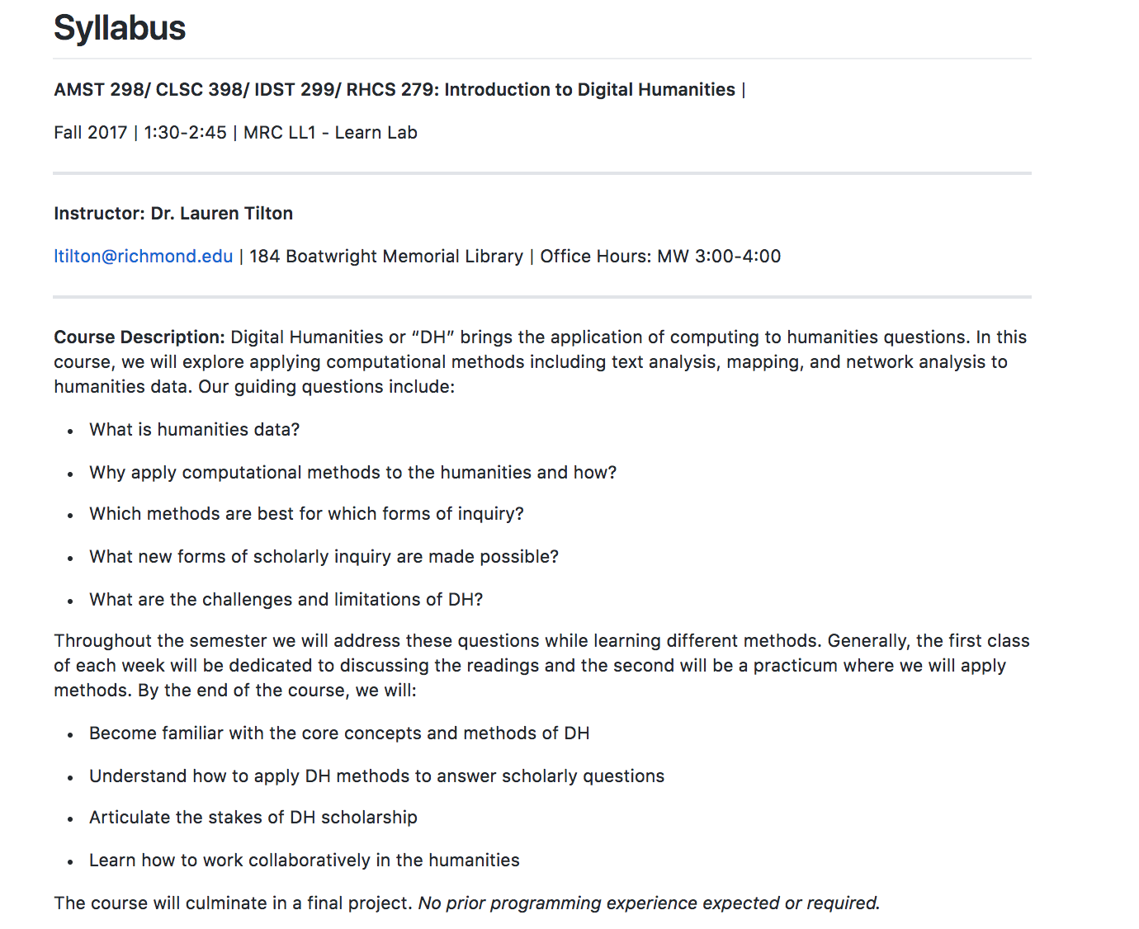

Slide 5
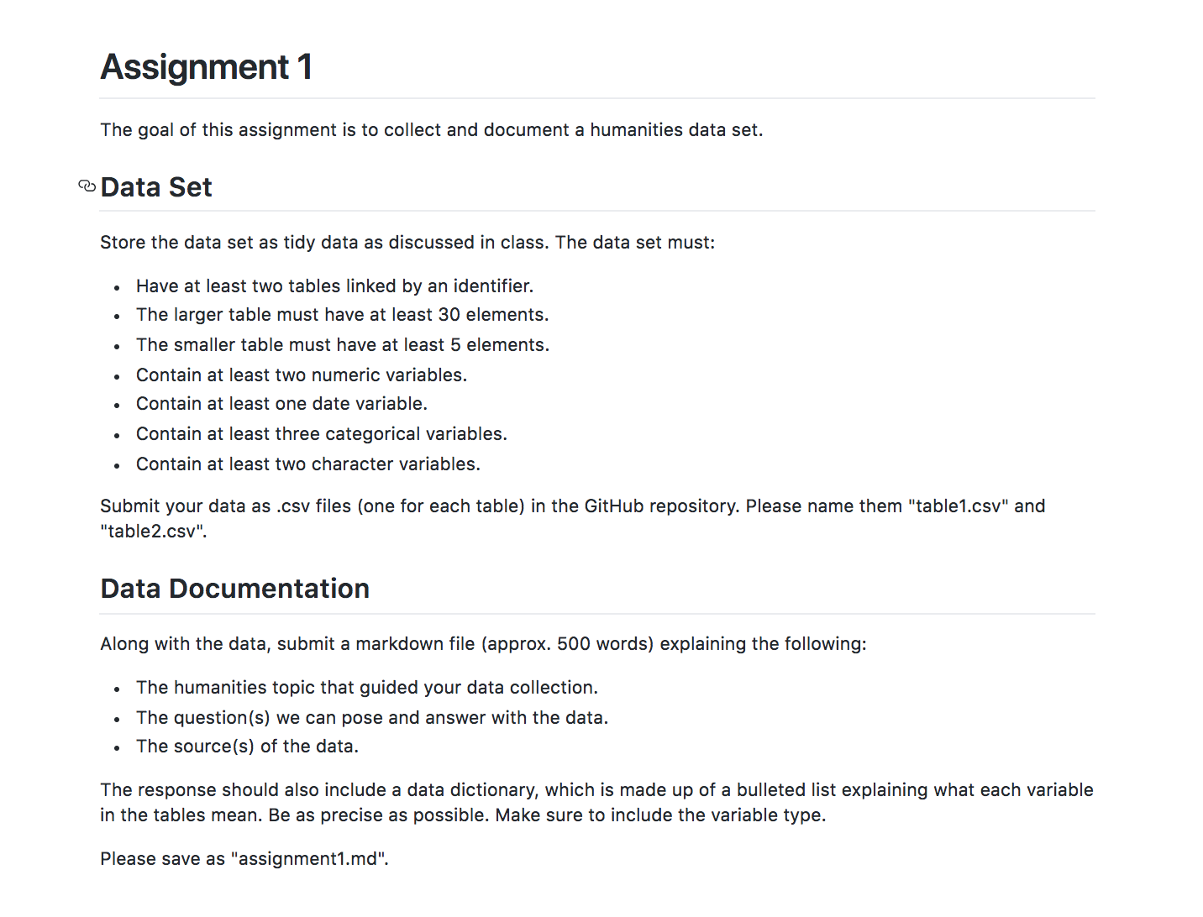
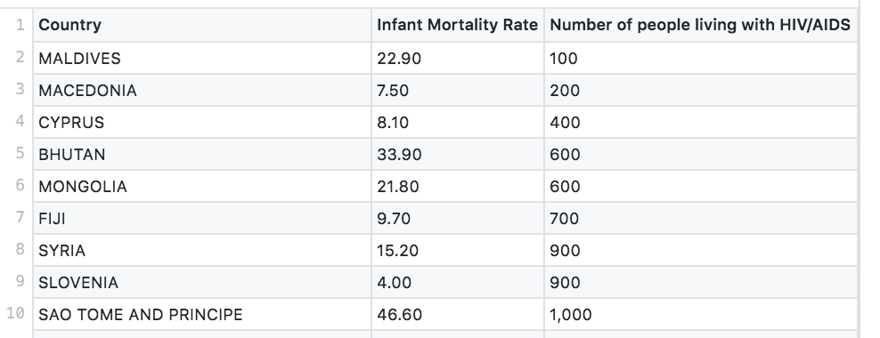
Data

Slide 6
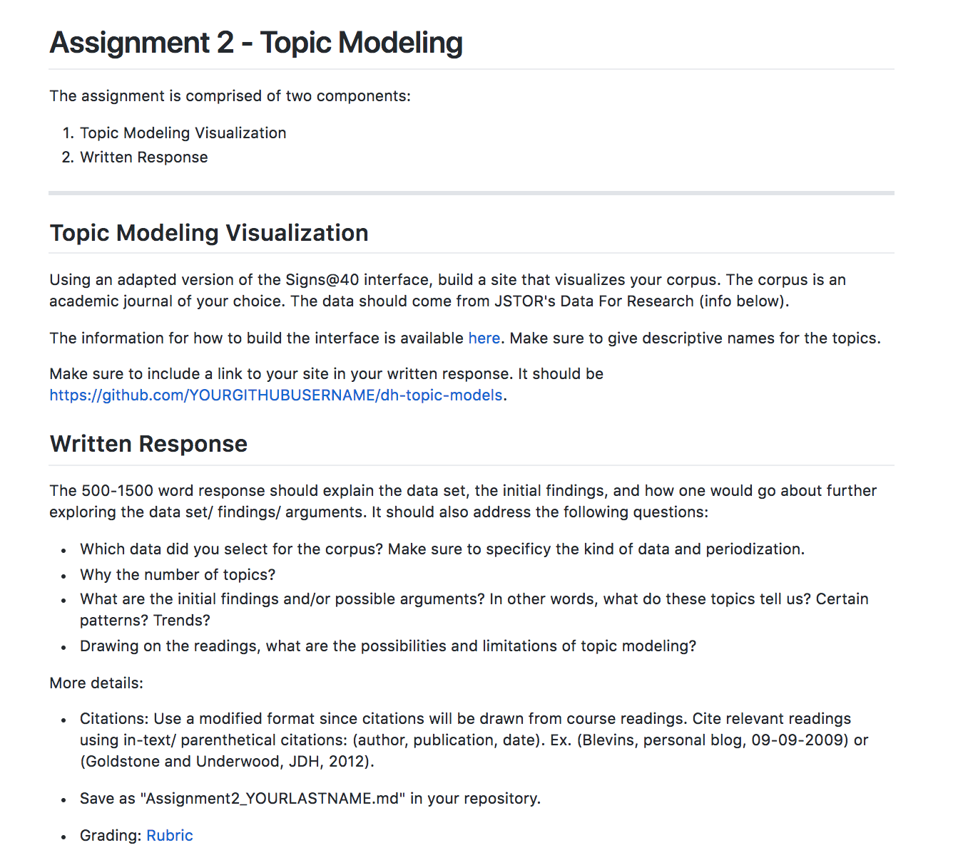
Text Analysis
Example: https://maanume.github.io/dh-topic-models/

Slide 7
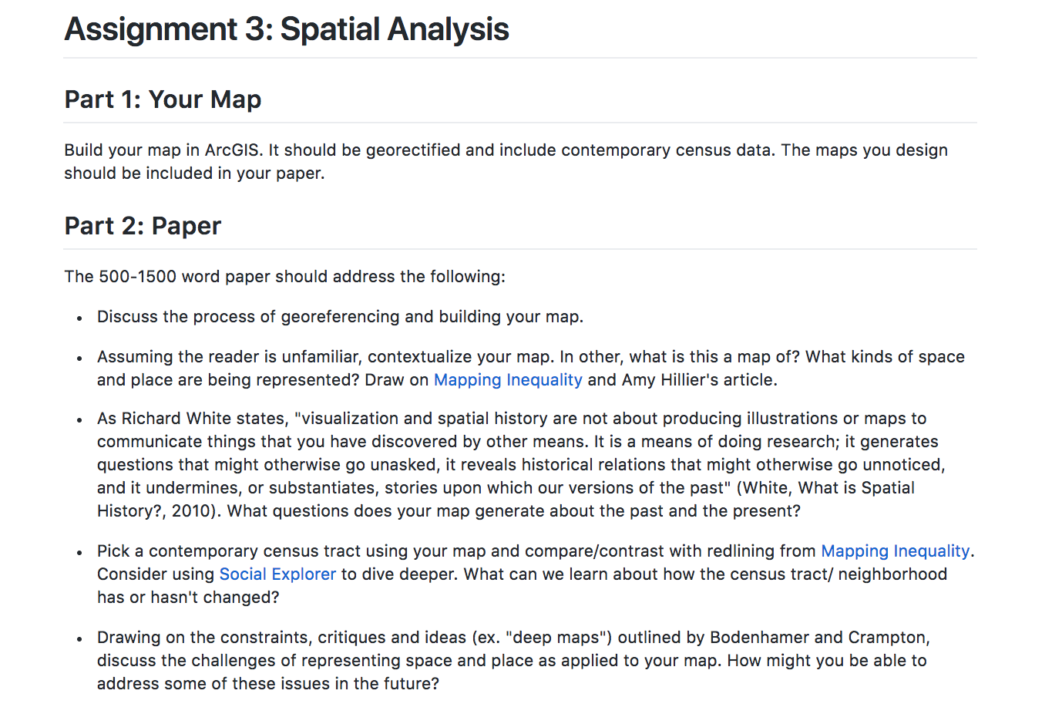
Spatial Analysis

Slide 8
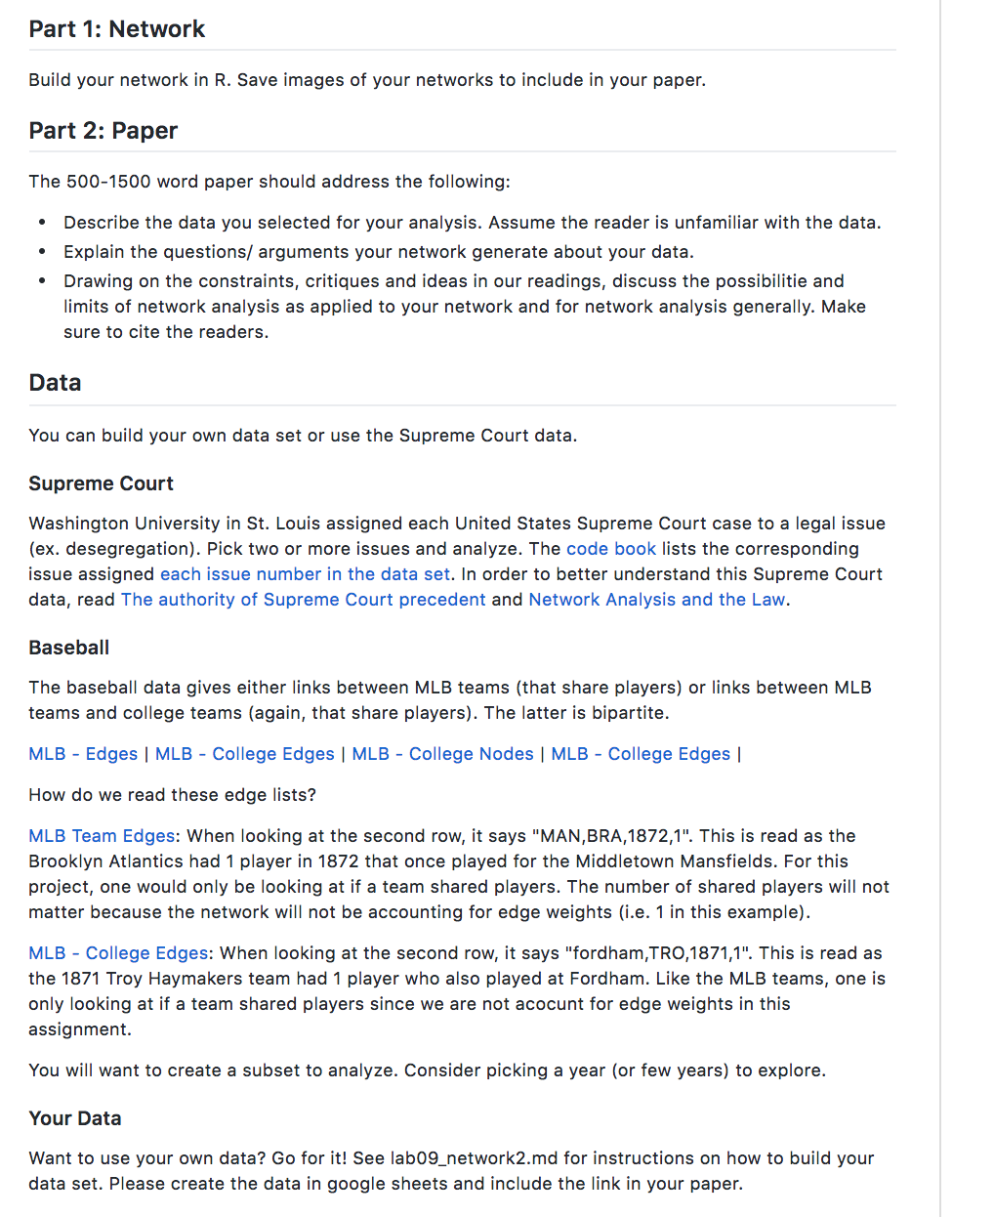
Network Analysis

Slide 9
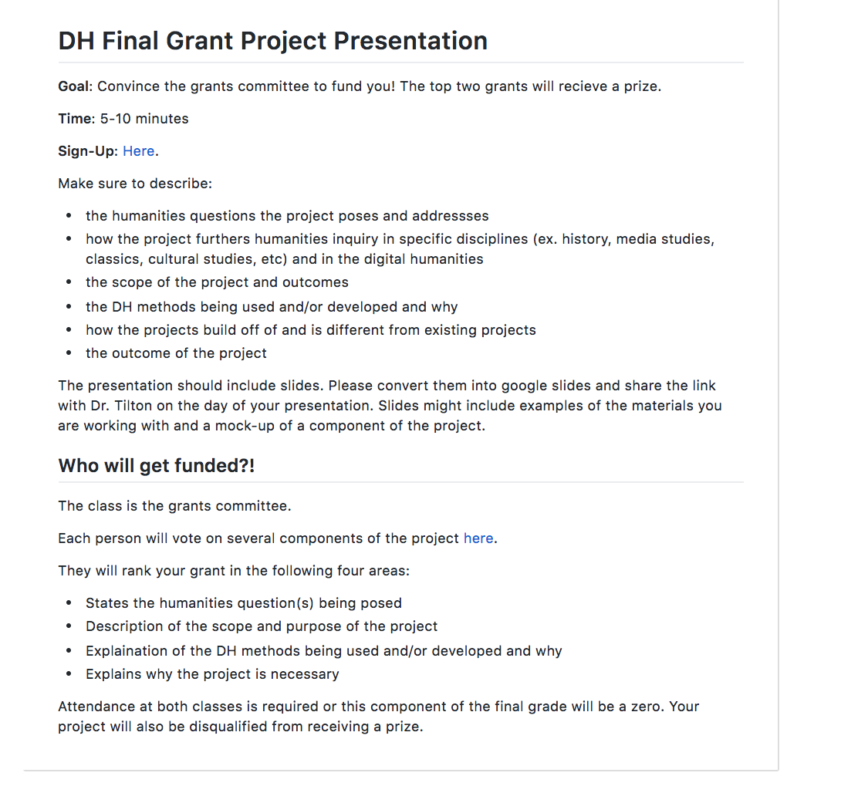
NEH Grant

Slide 10
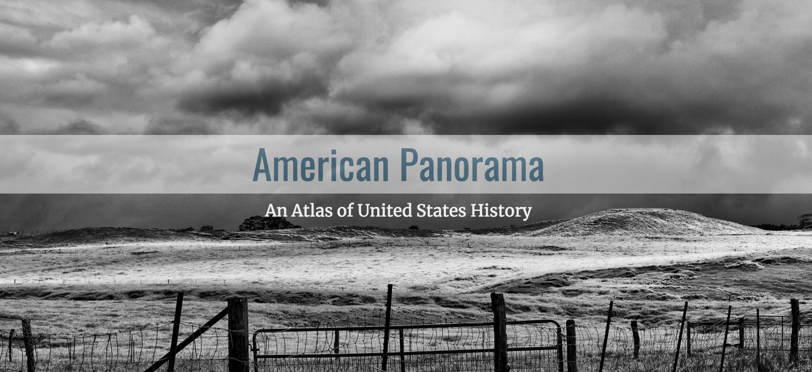


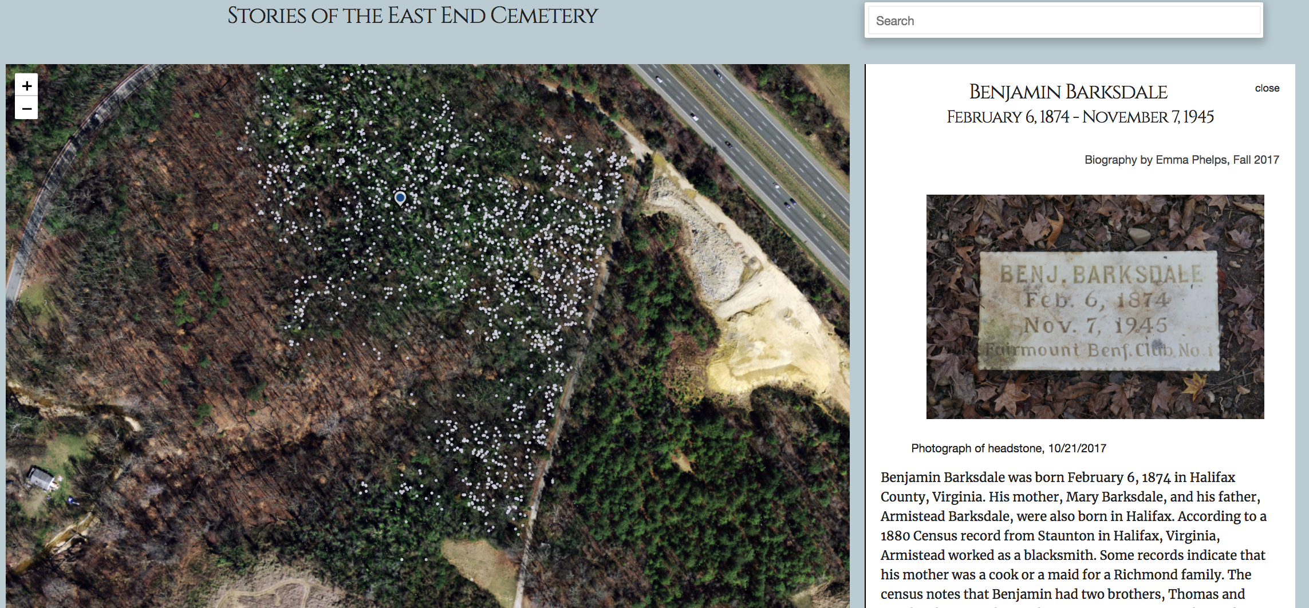
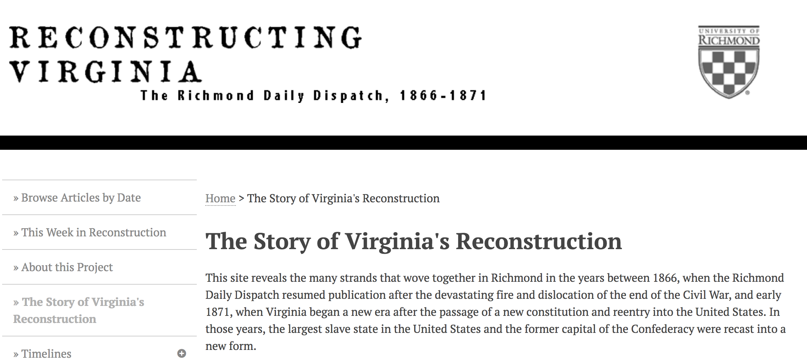
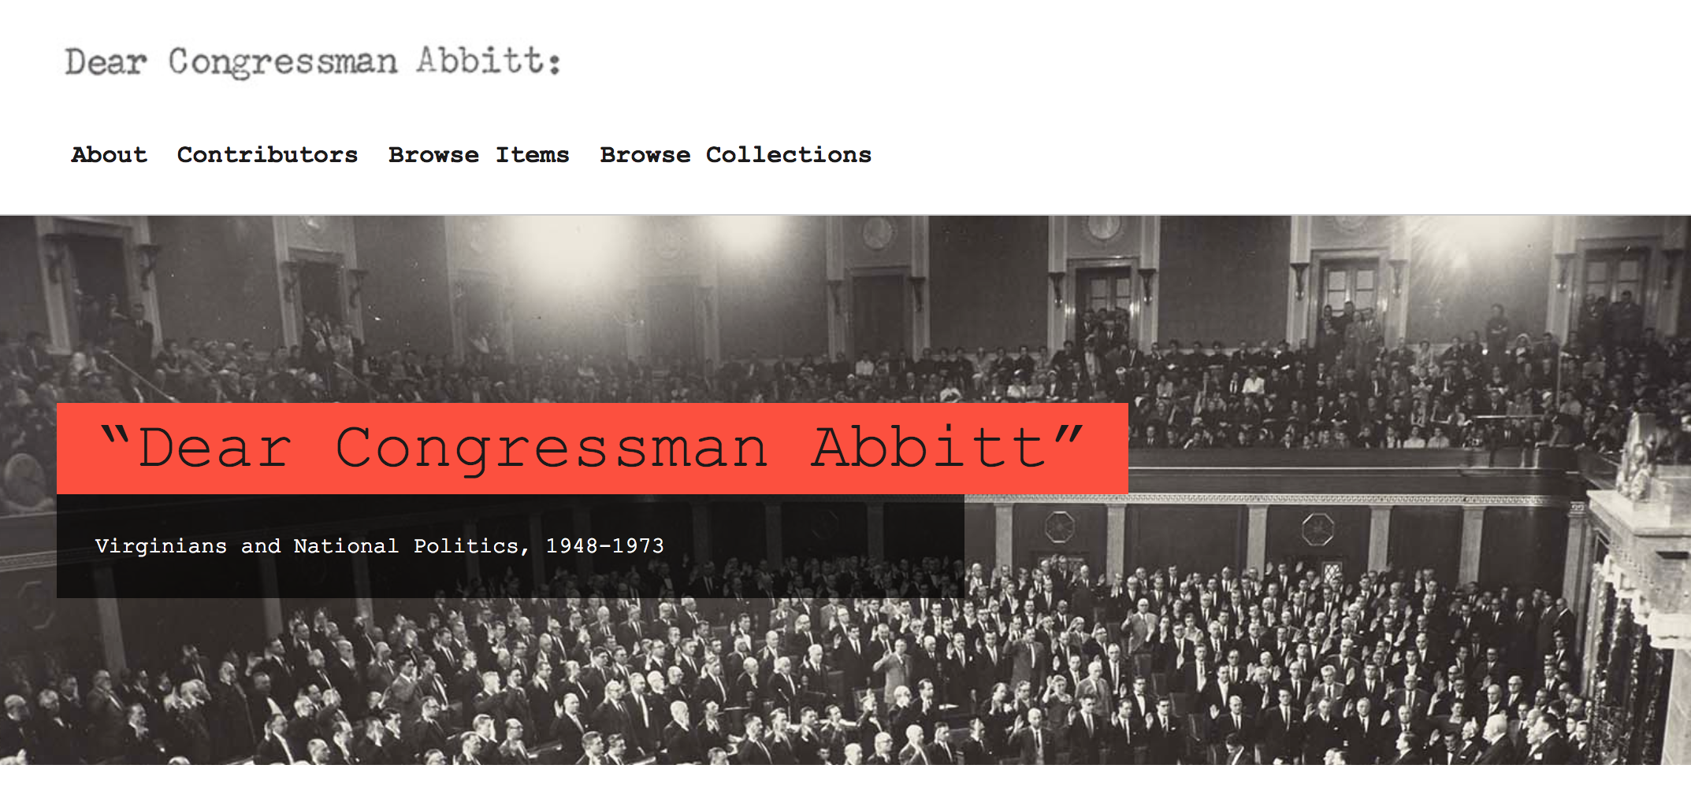
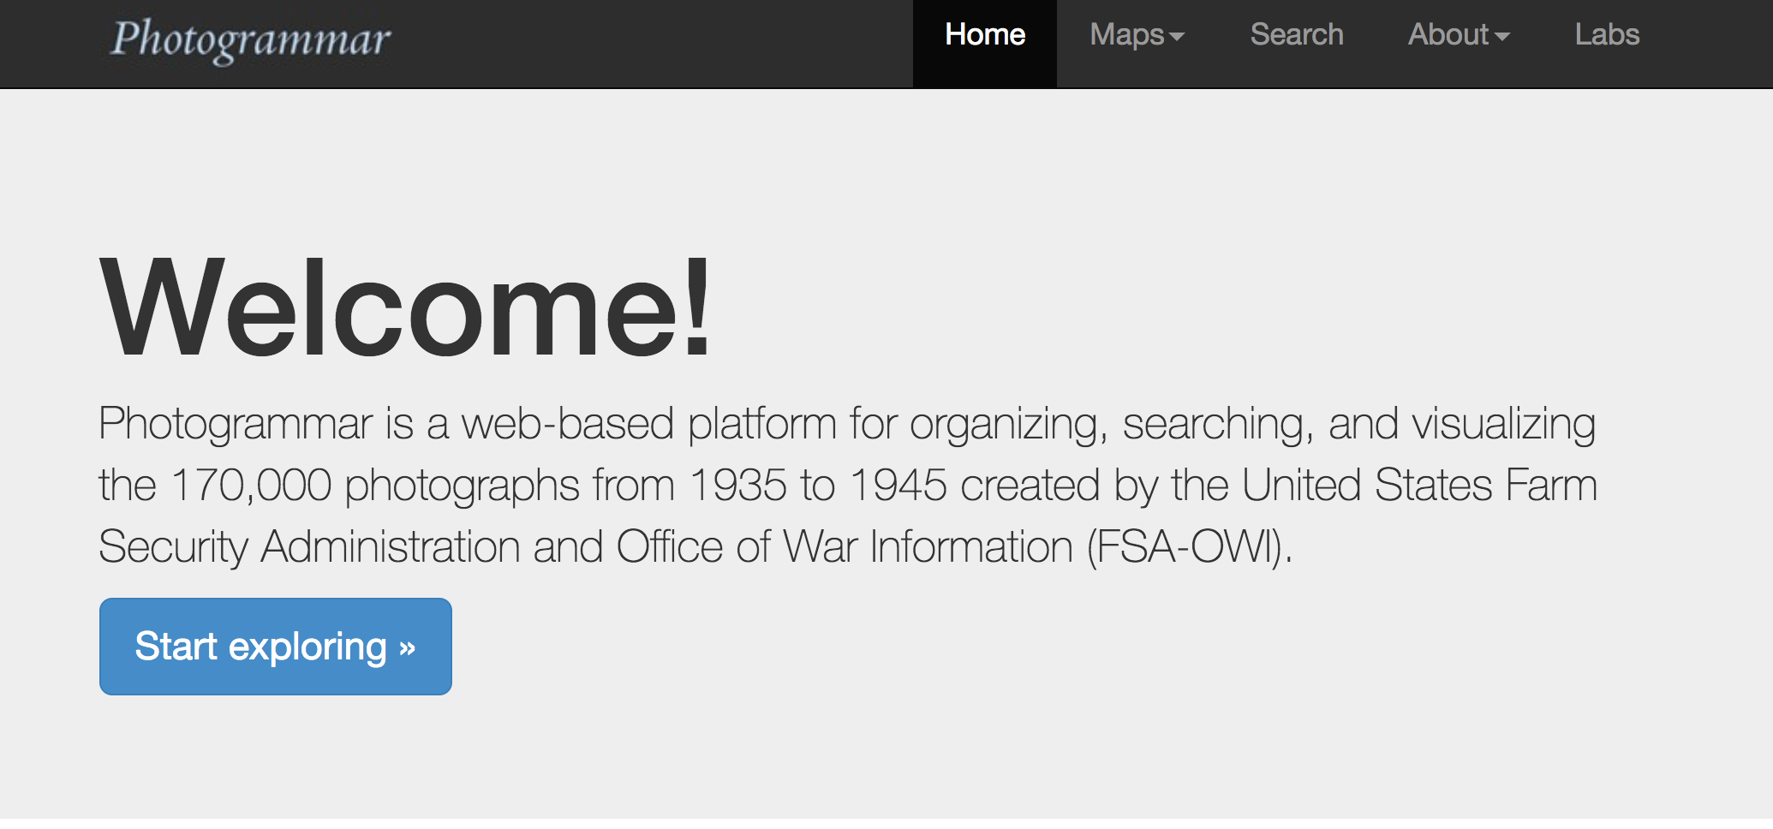
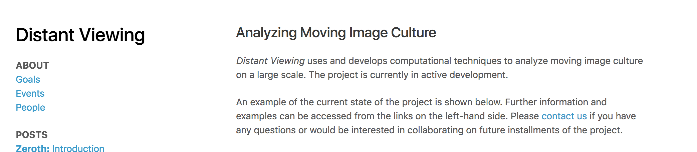

Slide 11
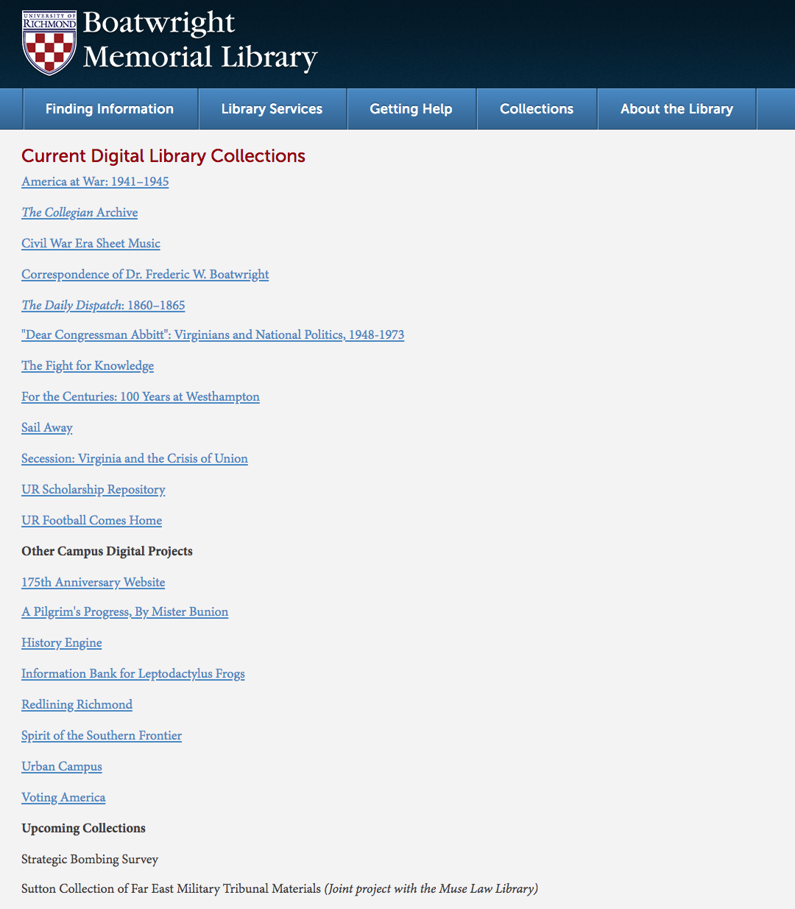

Slide 12
SylLabi

Slide 13
https://tinyurl.com/dhsyllabi

